Slide 1


Capstone Project:
Diabetes Patient Readmission
By:
Team PyPyPy
NYC Data Science Academy - Cohort ‘September 2019’
Mentor:
Brian Saindon

Slide 2


Content
Introduction
Background
Objectives
Timeline
Methodology
Data Preprocessing
Method and Modeling
Result & Discussion
Exploratory Data Analysis
Modeling
Lift Analysis
Financial Data
Summary
Future Work

Slide 3
Introduction: Background and Objective

Slide 4
Background
In-patient hospital accounts for the largest share of total health care spending
(29% in 2009)
In-patient hospital accounts for the largest share of total health care spending
(29% in 2009)
Diabetes is the 7th leading cause of death in the USA (2015)
Diabetes is the 7th leading cause of death in the USA (2015)
In 2010,
hospitalization relating to diabetes with complication was $4.9 billion
In 2010,
hospitalization relating to diabetes with complication was $4.9 billion
In 2018, total cost for diabetes related care was $327 billion
In 2018, total cost for diabetes related care was $327 billion
In 2015,
30.3 million Americans had diabetes
In 2015,
30.3 million Americans had diabetes
Identify high risk pool of diabetic patient for rehospitalization
Identify high risk pool of diabetic patient for rehospitalization
“ Hospital Readmission Reduction Program ”
“ Hospital Readmission Reduction Program ”
84.1 million American age 18 or older had prediabetes
Implementation of intervention for high risk population to reduce rehospitalization.
Implementation of intervention for high risk population to reduce rehospitalization.
Notes:
The average cost per stay is $9700,.
The 30-day risk standardized readmission measures include:
All-cause unplanned readmissions that happen within 30 days of discharge from the index (i.e., initial) admission.
Patients who are readmitted to the same hospital, or another applicable acute care hospital for any reason.

Slide 5

Objectives
“How does the model benefit?”
Identify features and conditions to focus on which aid in reducing rehospitalization, financial analysis
Model Applications:
Model performance, predictive performance, and lift chart
Intervention Team
Data Science Team
Model improvement, implementation and scaling
Data Engineering Team
Notes:
For the objective: (Paul)
Do we look in the big picture or small picture? I prefer to look in a big picture _ that will be the main purpose and it will be more broad to present to somebody who dont have the background

Slide 6
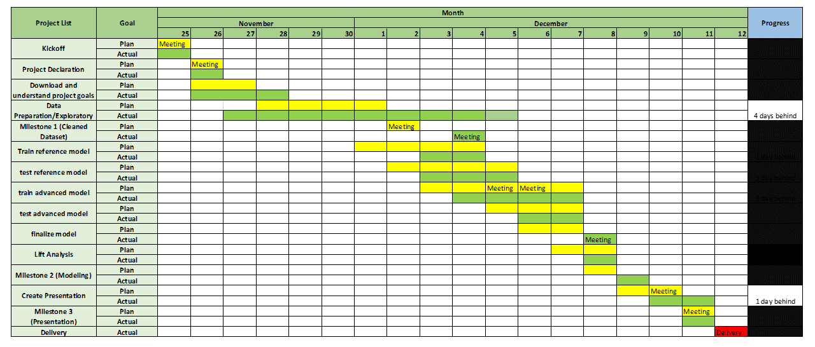
Project Timeline
Remarks: The delay on exploratory data analysis is because the team wanted to get more insight in modeling with different methods and findings

Slide 7

Challenges deep-dive
Challenge 1
Challenge 2
Challenge 3
Dataset Interpretation
Additional domain knowledge to interpret:
‘Admission_type_id’
‘Discharge_diposition_id’
‘Admission_source_id’
‘Payer_code’
‘Diag_XX’ columns
Highly Imbalanced Classifications
- Only 10% is re-admitted
Opaque hospital financial information
-Patient record are highly confidential
- Hospital costs are opaque and not publicly available
- Assumptions needs to be made for financial analysis

Slide 8
Introduction: Methodology

Slide 9








Software & Packages
Data Modeling Packages : Python v 3.7
Software
Imblearn
SMOTE
SKlearn
Model Selection
Metrics
Tree
XGBoost
LightGBM
Hyperopt
eli5
PydotPlus
Python 3. 7. 4 (Jupyter Notebook)
Microsoft Excel 2019
Data Cleaning Packages : Python
Pandas
Numpy
Data Visualization Packages : Python
Matplotlib
Seaborn

Slide 10
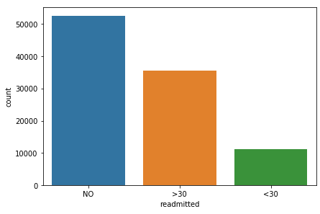
Exploratory Data Analysis
Value Count Results:
**********readmitted original**********
Values counts frequency
NO 54864 0.539119
>30 35545 0.349282
<30 11357 0.111599
**********readmitted cleaned**********
Values counts frequency
0 90409 0.888401
1 11357 0.111599
Target Output:
Column: ‘Readmitted’
3 unique values for feature:
“NO”, “>30”, “<30”
Target Output Information:
Target Output Information [‘Readmitted’]:
Convert “>30” and “NO” to 0
Convert “<30” to 1
Re-admitted (1) has frequency of 11.15%, revealing an imbalanced classification

Slide 11
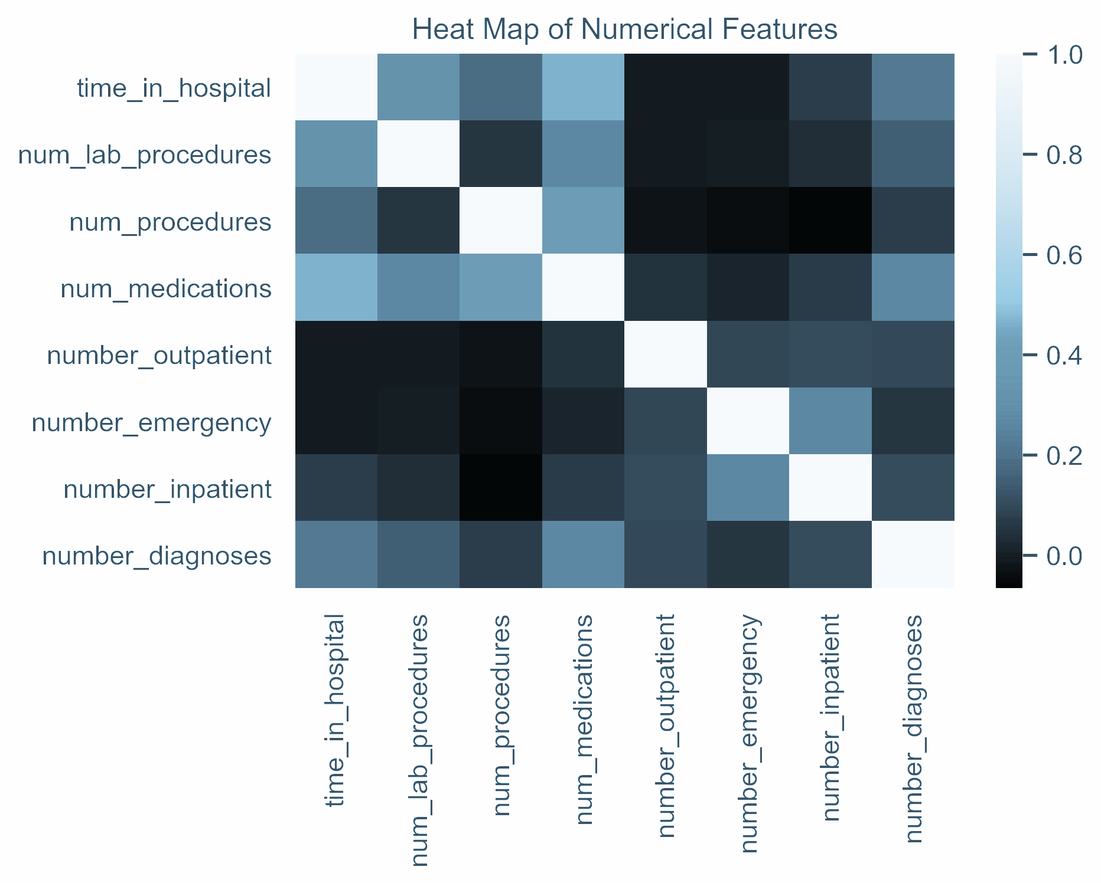
Exploratory Data Analysis
Numerical Column Data:
Converted mis-identified numerical features to categorical features.
(ex. ‘Encounter_id’ , ‘admission_type_id’, etc.)
Identified “True” numerical features
“ Heat Map of numerical feature correlations ”
Observation:
‘time _in_hospital’, ‘num_lab_procedure’, ‘num_procedure’, and ‘num_medications’ show strongest correlation
Notes:
Heat map of numerical features
time _in_hospital, num_lab_procedure, num_procedure, and num_medications show strongest correlation

Slide 12
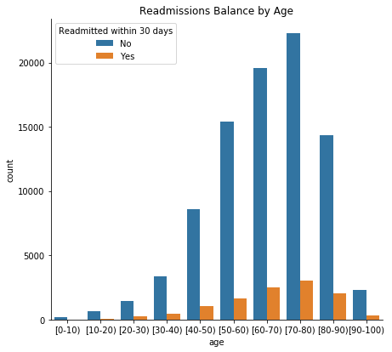
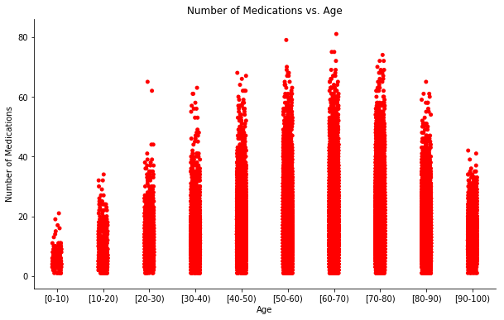
Exploratory Data Analysis

Slide 13
Feature Engineering
Value Count Results:
**********age original**********
values counts frequency
0 [70-80) 26066 0.256144
1 [60-70) 22482 0.220925
[50-60) 17256 0.169570
[80-90) 17197 0.168991
[40-50) 9685 0.0951725
[30-40) 3775 0.037096
[90-100) 2793 0.027446
[20-30) 1657 0.016283
[10-20) 691 0.006790
9 [0-10) 161 0.001582
Cleaning Categorical Data:
Replace imputed “?” with “unknown”
**********age converted**********
values counts frequency
0 75 26066 0.256144
1 65 22482 0.220925
2 55 17256 0.169570
3 85 17197 0.168991
4 45 9685 0.095172
5 35 3775 0.037096
6 95 2793 0.027446
7 25 1657 0.016283
8 15 691 0.006790
9 5 161 0.001582
Dropped “Unknown/Invalid” in
Gender since it was 0.0029% of data set
Converted Age to numerical data
Notes:
Clean
Feature by feature

Slide 14
Reduce dimensionality
Feature Engineering
‘admission _type_id’
‘discharge_type_id’
**********admission_type_id original**********
[ 8 unique values]
**********admission_type_id cleaned**********
Values counts frequency
0 urgent 72489 0.712332
1 elective 18868 0.185411
2 na 10396 0.102159
3 newborn 10 0.000098
**********discharge_disposition_id original**********
[ 25 unique values]
**********discharge_disposition_id cleaned**********
values counts frequency
0 home 73134 0.736199
1 assisted 15299 0.154006
2 hospital 5604 0.056412
3 na 5303 0.053382
High Cardinality Categorical Features
Consulted with MD and literature
for strategy and method to group related values to reduce dimensions.
‘admission _source_id’
‘diag_1’
**********admission_source_id original**********
[ 16 unique values]
**********admission_source_id cleaned**********
values counts frequency
0 urgent 55848 0.562190
1 referral 30433 0.306352
2 other 6869 0.069146
3 transfer 6185 0.062261
4 birth 5 0.000050
*******************diag_1 original******************
[716 unique values]
******************diag_1 cleaned******************
values counts frequency
Circulatory 29680 0.298772
Respiratory 13934 0.140266
Neoplasms 10883 0.109553
Other 10041 0.101077
Digestive 9333 0.093950
Diabetes 8661 0.087185
Injury 6851 0.068965
Genitourinary 5002 0.050352
musculoskeletal 4935 0.049678
? 20 0.000201
“Admission_type_id”
“Discharge_disposition_id”
“Admission_source_id”
“diag_1”

Slide 15

Dealing with Missingness
Missing Values
Missing Values
Feature Percentage Missing Value:
weight 96.85
medical_specialty 49.08
payer_code 39.55
race 2.23
diag_3 1.39
diag_2 0.35
diag_1 0.02
Replace “?” with “NULL”
Dropped
“weight” / “medical_specialty” / “payer_code”
Reason:
Significant missing data
Dropped
“diag_2” / “diag_3””
Reason:
Repetitiveness relative to ‘diag_1’

Slide 16

Feature Dummification
List of dummification features
'Race'
'gender'
'Admission_type_id'
'Discharge_disposition_id'
'Admission_source_id'
'Diag_1'
'Max_glu_serum'
'A1Cresult'
'Metformin'
'Repaglinide'
'Nateglinide'
'Chlorpropamide'
'Glimepiride'
'Acetohexamide'
'Glipizide'
'Glyburide'
'Tolbutamide'
Pioglitazone'
'Rosiglitazone'
'Acarbose'
'Miglitol’
'Troglitazone'
'Tolazamide'
'Insulin'
'Glyburide-metformin'
'Glipizide-metformin'
'Glimepiride-pioglitazone'
'Metformin-rosiglitazone'
'Metformin-pioglitazone'
'Change'
'diabetesMed'
Dummify categorical data
Before dummification >> df.shape
Rows : 99320 rows
Columns : 45 columns
After dummification >> df_dummified.shape
Rows : 99320 rows
Columns : 94 columns
Notes:
df.shape -> (99320, 45)
df_dummified.shape -> (99320, 94)

Slide 17
Multiple Encounters
“Multiple encounters”
“Unique patient ID”
Multiple encounters
Unique patient ID
Rows : 99320 rows
Columns : 94 columns
Rows : 78727 rows
Columns : 94 columns
For this dataset, multiples in the training data will bias the model
For the unique dataset, multiple encounters are considered to drop by keeping “first” encounter within the dataset.

Slide 18
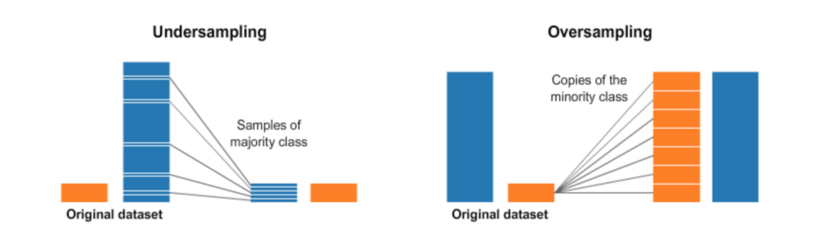
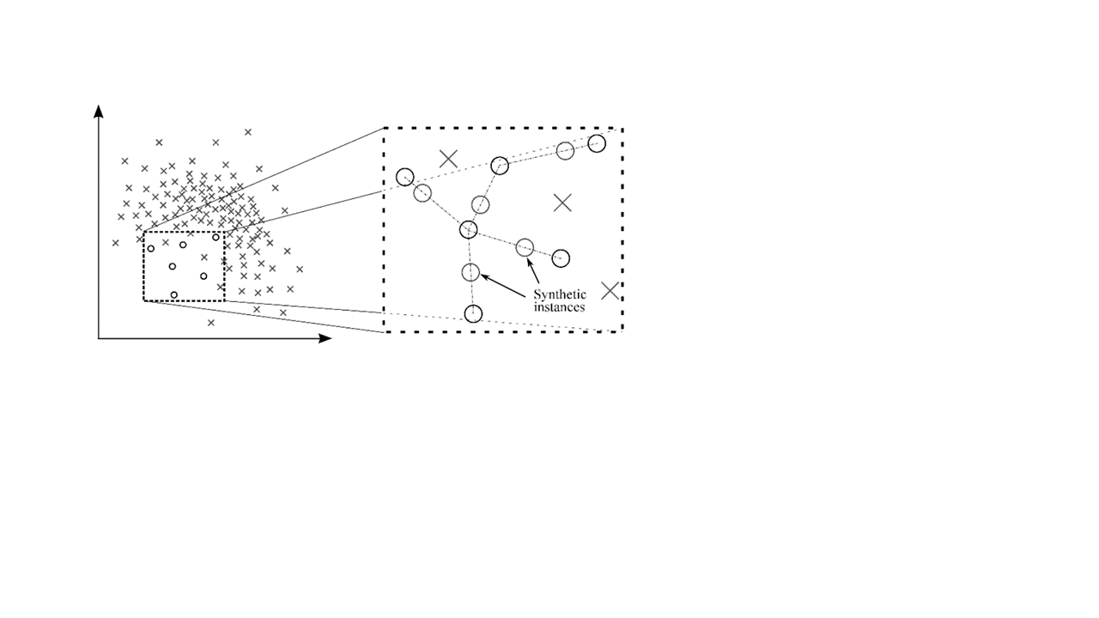
Imbalancing Classification
Synthetic Minority Over-sampling TEchnique
(SMOTE)
Imbalanced Dataset
Resampling Techniques
- Random Under-Sampling
- Random Over-Sampling
- Cluster-Based Over Sampling
- Informed Over Sampling: Synthetic Minority Over-sampling Technique
- Modified synthetic minority oversampling (MSMOTE)
Advantages
Mitigates the problem of overfitting caused by random oversampling
as synthetic examples are generated rather than replication of instances
No loss of useful information
Disadvantages
While generating synthetic examples SMOTE does not take into
consideration neighboring examples from other classes. This can
result in increase in overlapping of classes and can introduce
additional noise
SMOTE is not very effective for high dimensional data
Notes:
Binary Logistic Regression
Since the task at hand was to differentiate between the class of interest/success (readmission under 30 days) vs. all others (collectively as readmission at 30 or more days), logistic regression was selected as a baseline model . Cost-efficient implementation meant minimal training times; we able to quickly get results for score benchmarking as well as gauging the quality of a given dataset.
Tree Model
Decision Trees and Random Forest
As no member of our team has extensive domain knowledge on the subject, tree models were selected because of their ease of deployment. The majority of the features were categorical in nature, which made tree models a natural choice in trying to predict readmission. Findings from tree models are also easier to interpret than higher complexity models, which facilitates conversations with the business.
TreTree Modelse Models
Tree Models

Slide 19
Modeling
Dataset:
Unique Encounter
Train/Test Split 70:30
Train/Test Split 75:25
Train/Test Split 80:20
Train/Test Split 85:15
All Encounter
Train/Test Split 70:30
Train/Test Split 75:25
Train/Test Split 80:20
Train/Test Split 85:15
Modeling
Logistic Regression
Decision Tree
Random Forest
XGBoost
LightGBM
Balancing
Technique
Balancing
Technique
Balancing
Technique
SMOTE
SMOTE
SMOTE
Base Model
weight_balance
Parameter Optimization
Randomized Search
Feature Importance
Parameter Tuning
Gini
Parameter Optimization
Grid Search
Entropy
Feature Importance

Slide 20
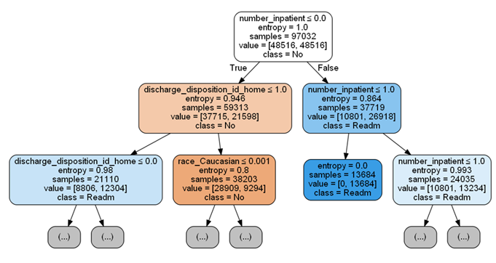
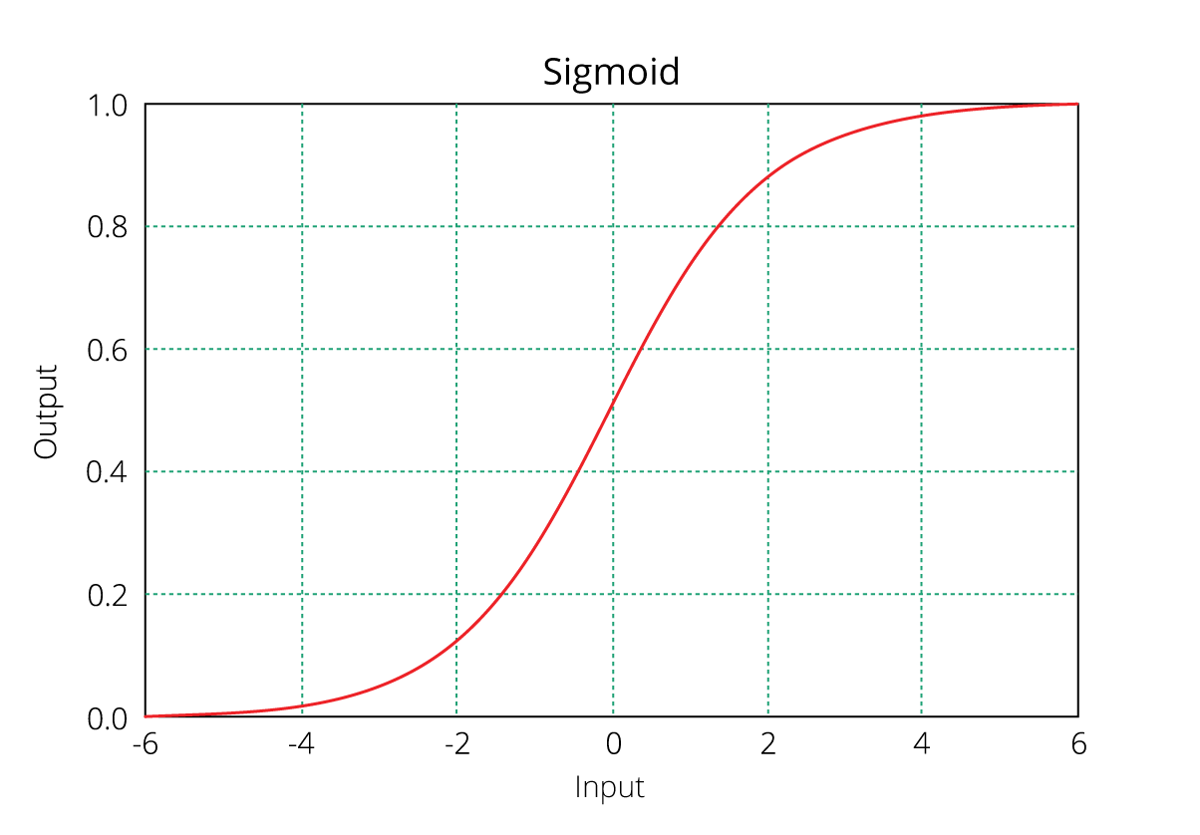
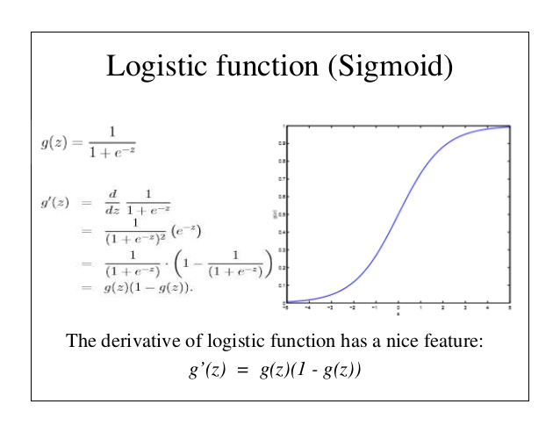
Modeling
Tree Based Models
Decision Trees Model– Classifier
Advantages:
Handles qualitative predictor without need for dummy variable
Missing values are acceptable
Simple and easy to interpret than high complexity models.
Suitable for categorical variables
Disadvantages:
Complexity of the model with many trees with “Overfitting” issues
Logistic Regression
Binary Logistic Regression - Classifier
Based on the Sigmoid function to solve
“Binary Classification” problem
Less complexity
Random Forest Model– Classifier
Use ensemble techniques to grow trees by calculating statistical values of each run called “Out-of-Bag(oob)” to reduce overfitting problems.
Notes:
Binary Logistic Regression
Since the task at hand was to differentiate between the class of interest/success (readmission under 30 days) vs. all others (collectively as readmission at 30 or more days), logistic regression was selected as a baseline model . Cost-efficient implementation meant minimal training times; we able to quickly get results for score benchmarking as well as gauging the quality of a given dataset.
Tree Model
Decision Trees and Random Forest
As no member of our team has extensive domain knowledge on the subject, tree models were selected because of their ease of deployment. The majority of the features were categorical in nature, which made tree models a natural choice in trying to predict readmission. Findings from tree models are also easier to interpret than higher complexity models, which facilitates conversations with the business.
TreTree Modelse Models
Tree Models

Slide 21
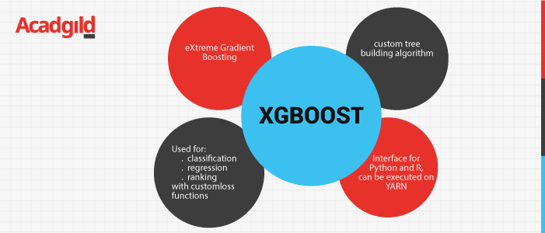
Modeling
Extreme Gradient Boosting (XGBoost)
Derived from gradient boosting framework to reduce overfitting problems by adopting gradient boosting with highly effective computational.
Parallelization - parallel tree building instead of sequential
Hardware - allocate internal buffer for more efficient hardware utilization
Wide variety of tuning
Cross-validation
Regularization
Missing values
Tree parameters
Compatible with SCIKIT-LEARN

Slide 22
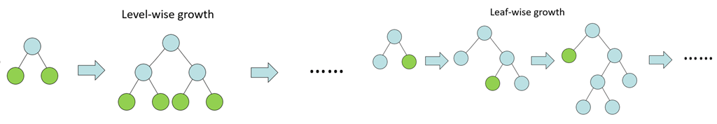
Modeling
Light Gradient Boosting Model (Light GBM)
Based on Bayesian Optimization for hyperparameter tuning/selection to boost up model performance
Growing trees leaf-wise as opposed to depth-wise by gradient boosting model.
Executing faster because of less leaves that opposed to the node or depth level.
Wide variety of hyper parameter tuning

Slide 23
Lift Analysis
Methodology
Lift analysis can be used as a metric to evaluate the performance and quality of models
Accuracy and other metrics are not as useful in evaluating model performance when the classes are as imbalance as the diabetic data set
Lift analysis can be used to identify a high risk populations, which then can be targeted for intervention

Slide 24
Financial Approaches
Modeling Approach/ Plan
Cost per Stay:
Based on data from 1997 and 2010 ^{[ 4]}:
hospitalization cost for diabetes mellitus with complication is expected to be $10,000 per stay
Admitted days:
Based on data from 2005 and 2014 ^{[ 3]}:
Using “extrapolate approach” to calculate average number of days that patient admitted.
X̅ _{number of days,2005}= 5.7 days
X̅ _{number of days,2014}= 5.3 days
X̅ _{numbers of day,2019} = 5.2 days
Extrapolating Method
Notes:
https://www.hcup-us.ahrq.gov/reports/statbriefs/sb146.pdf
Inpatient hospital service account for 7% of health care utilization but constitute the largest share of total health care spending, 29% in 2009.
Hospital cost by age 2010
Average cost per hospital stay was $9700, aggregated cost for all hospital stays totaled $375.9 billion
Adults 45-64 and 65-84 had the highest average cost per stay $12100, $12300 respectively.
Diabetes mellitus with complications
1997 $2.9
2010 $4.9
1997 per stay$7,100
2010 per stay $9,000
4.1% average annual percentage increase in aggregate costs
https://www.diabetes.org/resources/statistics/cost-diabetes
$237 billion in direct medical cost, 30% of which is for hospital inpatient
https://care.diabetesjournals.org/content/41/5/e72?ijkey=89f233e9938d288d3ca29f917f4e052a7e69fca6&keytype2=tf_ipsecsha
Mean length of stay decreased significantly from 5.7 to 5.3 days during the years 2005-2014.
Total cost of hospitalizations due to diabetes-related preventable causes significantly increase from $5.32 to $6.28 billion for the same period..

Slide 25
Results & Discussion

Slide 26
Model Results - Summary (Part 1)
Selected Dataset
Criteria : highest Area Under Curve [AUC] scores
Dataset: Dropping unique ‘encounter_id’
Train/test : 70:30

Slide 27
Model Results - Summary (Part 2)

Slide 28
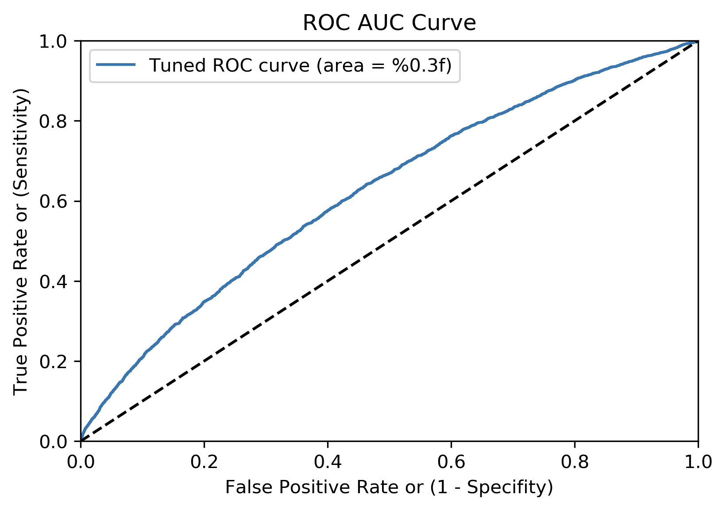
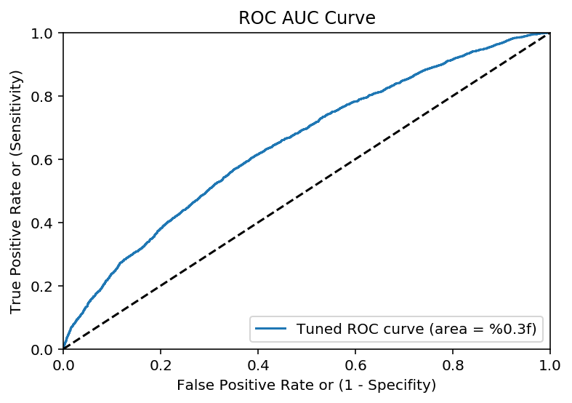
Model Results
LightGBM
Logistic Regression
Light Gradient Boosting Model (Light GBM)
Curve for 70:30 whole train vs. unique test, with AUC = .585
Curve for 70:30 whole train vs. unique test, with AUC = .649

Slide 29
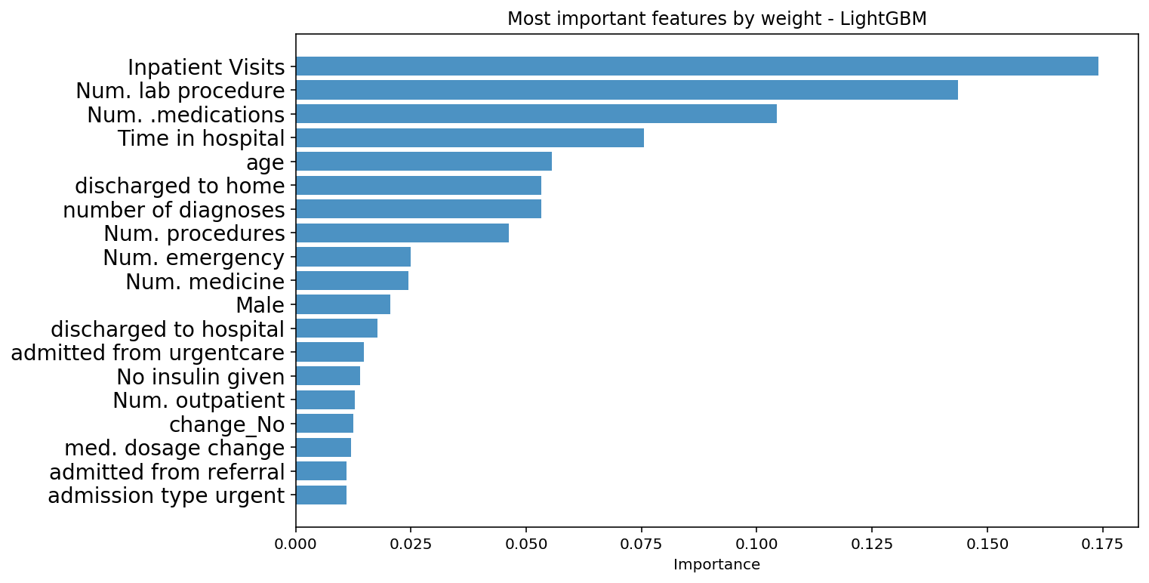
Feature Importance by Weight

Slide 30
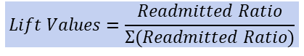
Lift Analysis Summary
LightGBM: Readmitted Under 30 Days
LightGBM
$$Lift Values=\frac{Readmitted Ratio}{Σ(Readmitted Ratio)}$$

Slide 31
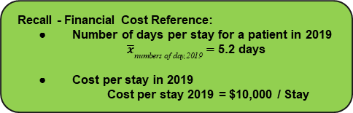
Financial Analysis
Recall - Financial Cost Reference:
Number of days per stay for a patient in 2019
${\overline{x}}_{\text{numbers} \text{of} \text{day}\text{,2019}}=$ 5.2 days
Cost per stay in 2019
Cost per stay 2019 = $10,000 / Stay
Lift Analysis Method
Definition: “High-risk” - Lift Score > 1
Quantile Rank | Unique Patients (Quantile) | Actual Readmitted | Avg. Prob | %_Readmitted | Lift | Cost “High-risk” group Over Lift of 1
7 | 2590 | 269 | 0.11257 | 0.10386 | 1.0834506 | $3,031,061.40
8 | 2590 | 301 | 0.13227 | 0.11622 | 1.2123369 | $3,795,099.43
9 | 2590 | 378 | 0.15989 | 0.14595 | 1.5224695 | $5,985,132.10
10 | 2591 | 553 | 0.23258 | 0.21343 | 2.2264569 | $12,804,798.92
Saving cost = $25,616,091.85
[Cost to treat “high-risk” group = Saving cost] for hospital that to reduce readmitted patients in 7th -10th Quantile
Notes:
lift score * cost per stay avg lift * cost per stay cost from lift over average
23,155.15 12,755.15 7,053,599.08

Slide 32
Summary

Slide 33
Summary
Imbalance data was a major consideration in the data cleaning and modeling
Readmission rate was ~11% compare to ~89% no or more than 30 days readmission
Complex models provided improved Area Under the Curve (AUC) score over logistic regression
Drawback of complex models is computational expense
Lift analysis provided a metric to identify ‘high-risk’ population
Accuracy as a metric for model performance is poor because the data is imbalanced.
Lift Analysis indicates that this model will help a hospital to save $25,616,091.85/ annum [based on 2019 data].
Key features are identified for intervention team
Key features can be a good guideline to improve treatment to enhance readmission reduction
Notes:
Identified a list of feature for intervention team
Key features can improve treatment to reduce readmission

Slide 34
Future Work Suggestion

Slide 35

Future Work Considerations
Focus for future work is to improve the accuracy of model prediction with other methods and approaches
Use PCA[ “Unsupervised learning”] to identify feature importance that can be practically implemented within a hospital to reduce the inherent risk of diabetes patient readmission.
Address the false negative/true positive imbalance, a custom cost function could be implemented which would “penalize” the models more heavily for incorrectly classifying a patient as a false negative. This should in theory increase the true positive rate, resulting in larger AUC.
Re-run model on selected features generated from feature importance
Additional models
Support Vector Classifier (SVC)
K Neighbors Classifier
Stochastic Gradient Descent (SGD Classifier)
Catboost
Additional parameter tuning

Slide 36
Reference
;
Dataset Reference:
[1] UCI Machine Learning Repository: Diabetes 130-US hospitals for years 1999-2008 Data Set. (n.d.). Retrieved from https://archive.ics.uci.edu/ml/datasets/diabetes+130-us+hospitals+for+years+1999-2008
Financial Reference:
[2] The Cost of Diabetes. (n.d.). Retrieved from https://www.diabetes.org/resources/statistics/cost-diabetes
[3] Trends in Diabetes-Related Preventable Hospitalizations in the U.S., 2005?2014. (2018, May 1). Retrieved from https://care.diabetesjournals.org/content/41/5/e72?ijkey=89f233e9938d288d3ca29f917f4e052a7e69fca6&keytype2=tf_ipsecsha
[4] Pfuntner, A., Wier, M.P.H., L. M., & Steiner, M.D., M.P.H., C. (2013). Costs for hospital stays in the united states 2010. Healthcare Cost and Utilization Project

Slide 37
Github Link
;
Please click the hyperlink to direct to “Diabetest Readmission” Github Repo:
“Diabetes Readmission”

Slide 38





The team: PyPyPy
Paul
Emanuel
Stephen
Xing
Kevin
Charoenpong Songdechakraiwut
Emanuel Pizaña
Stephen Oakey
Xingwang Chen
Haining Fu

Slide 39

Thank you for your attention
Q&A

Slide 40
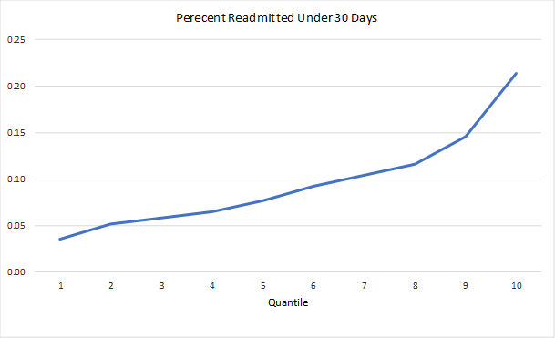
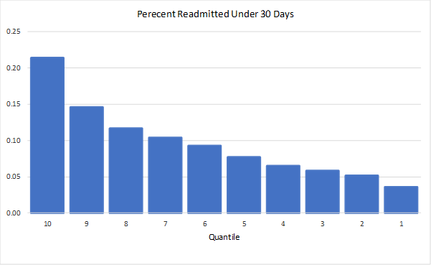
Lift Analysis Summary
LightGBM: Readmitted Under 30 Days
LightGBM

